Slide 1













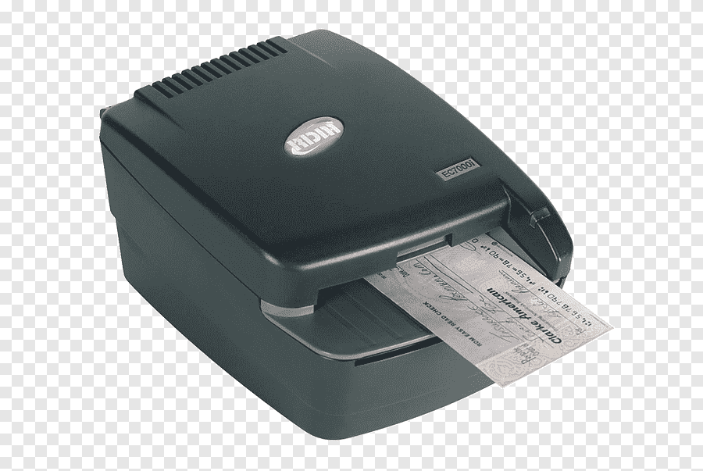



NIFT Cheque Clearing System Architecture Diagram
NIFT Datacenter MZ
Cheque Master
IBCS
DMZ
Linux Loader
Linux IBCS Middleware
RTGS DB
PDF DB
WAF & IBCS Reverse Proxy
SFTP Pusher
Puller
Bank A
Linux CRS
Server
Image DB
Auth DB
Auto Email
MPLS
IBCS FE
Bank B
Perimeter
Firewall
Data Repository
Offline
Primary SDWAN
Contingency Forti token
Data Canter
Firewall
Bank C
Cheque Pro
NIFT Center 1-27
SFTP Gateway
MS Exchange
Edge Transport Server
IBCS Convertor
.NET Core
Linux Server
Cheque Pro/ MS SQL
Cheque Scanning
Windows Client
Report Printing
Windows Client
SFTP Client
voyager

